Slide 1
Everything has beauty, but not everyone can see.
– Confucius
Lecture 9 – Introduction to Brute-Force
CST370 – Design & Analysis of Algorithms
Dr. Byun
Computer Science

Slide 2
Lecture Objectives
After completion of this lecture, you will be able to
  explain the basic idea of the brute-force approach in problem solving.
  use simple sorting algorithms to enumerate several items in order.

Slide 3
Introduction to Brute-Force
Brute force is a straightforward approach to solving a problem, usually directly based on the problem statement and definitions of the concepts involved.
  In other words, "Just do it!".
Often, the brute-force strategy is indeed the one that is easiest to apply.
  Though rarely a source of clever or efficient algorithms, the brute-force approach should not be overlooked as an important algorithm design strategy.

Slide 4
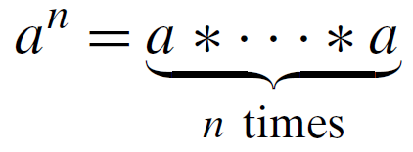
Example
Assume that you should compute a^{n} for a nonzero number a and a nonnegative integer n.
  Example: 3⁵ = 3 * 3 * 3 * 3 * 3
  By definition of a^{n}, you can simply multiply as below:

Slide 5
Chapter 3: Brute Force and Exhaustive Search
3.1 Selection Sort and Bubble Sort
3.2 Sequential Search and Brute-Force String Matching
3.3 Closest-Pair and Convex-Hull Problems by Brute Force
3.4 Exhaustive Search
3.5 Depth-First Search and Breadth-First Search

Slide 6
Selection Sort
Since you already took CST238 or a similar data structure course before, I will not cover it in CST370.
But to recall the algorithm, watch the following video.
  http://y2u.be/GUDLRan2DWM

Slide 7
Bubble Sort
Watch this video
  http://y2u.be/Jdtq5uKz-w4
  Note that the video introduces a “flag” variable to check if the remaining numbers are already sorted or not, which could improve the overall performance.

Slide 8
Puzzle

Slide 9
Solution

